Slide 1
Chips: Snack-Foods
August 2023
Retail Analytics and Commercial Application - Report

Slide 2
Executive summary
Mainstream mid-age and young singles and couples are more willing to pay more per packet of chips compared to their budget and premium counterparts.
The number of chips transactions dramatically increases prior to Christmas. Thus, added visibility to customers via a promotional display or Gondola end would increase purchases driving sales growth over this holiday period.
Mainstream Young Singles & Couples are the primary shopper of chips. Young and Older Families make up 26% of Chips shoppers and on average purchase larger baskets. There is more opportunity for sales with these shoppers.
01
Task 1
02
Task 2
A control store was constructed to reflect the prior performance of the selected trial store.
After implementing the new store layout the performance of the trial store and the control store were compared. The trial store saw significant uplift from the new store layout

Slide 3
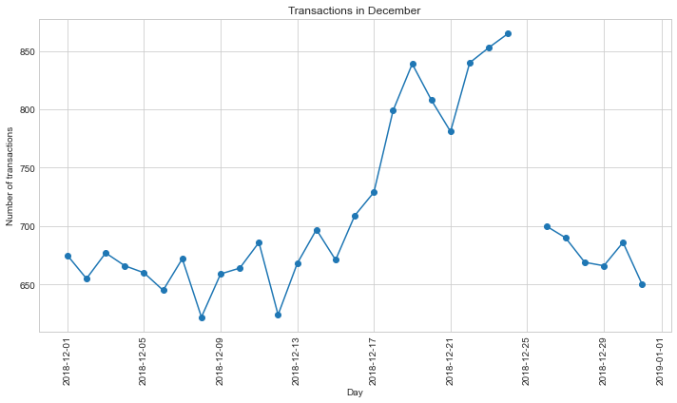
The number of Chips transactions has remained relatively consistent over a period of time; a notable increase occurred in the week leading up to Christmas The total number of transactions in the week including Christmas was negatively affected by public holiday store closure

Slide 4
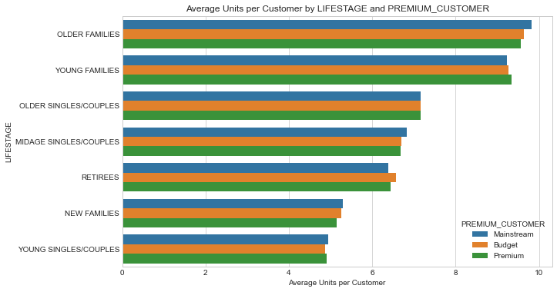
Affluence appears consistent across each individual life stage profile; Older and Young Family shoppers purchase the highest avg units per transaction

Slide 5
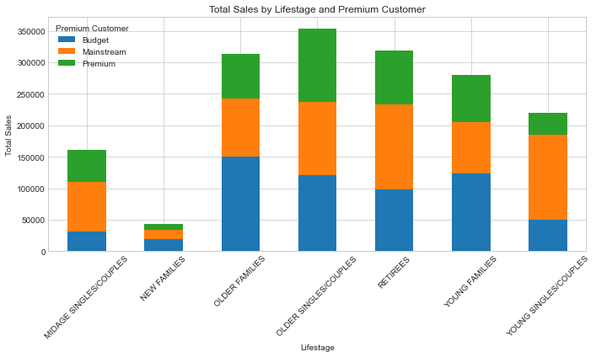
Sales are coming mainly from Budget - older families, Mainstream - young singles/couples, and Mainstream - retirees and Premium - Older singles/couples
Percentage wise, Mainstream Young Singles & Couples make up the largest proportion of Snacking Chips shoppers; Mainstream Retirees also have a significant share

Slide 6
Trial Store Performance:
We’ve found control stores 264, 155, 217 for trial stores 77, 86 and 88 respectively. The results for trial stores 77 and 88 during the trial period show a significant difference in at least two of the three trial months but this is not the case for trial store 86. Overall, the trial shows a significant increase and uplift in sales.

Slide 7
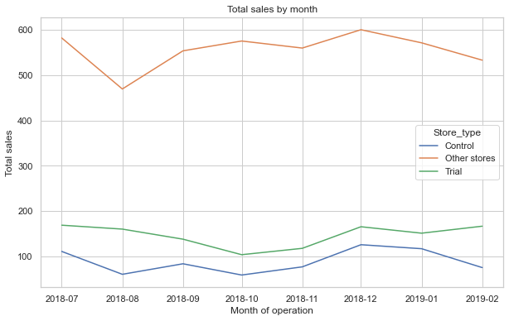
We found that the control stores had different market trends compare to other stores by total number of customers and total sales by month.

Slide 8
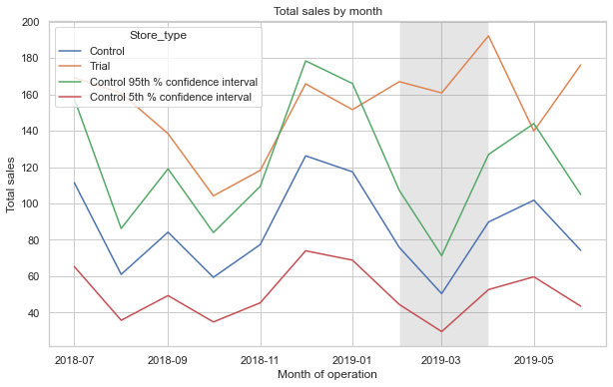
From Feb to May the trial store outperformed the control store highlighting the success of the new store layout

Slide 9
Recommendations:
I am pleased to advise that we have completed the analysis for the category, with a focus on consumer behavior and the trial store layouts.
At a high level we have found that:
Mainstream Young Singles & Couples remain the primary shoppers of chips
Opportunities have been identified with Young and Older Families
Trial store performance was increased as a result of the new store layout
We are looking forward to discussing these results further.
Warm regards,
Sunday Danladi
Associate Analyst, Virtual Participant at Quantium

